Slide 1

Terrapin Attack: Breaking SSH Integrity
Presentors: Yahel Koler & Uriel Dolev

Slide 2
The SSH Protocol
Created as a secure alternative to other shell protocols
Widely Used today for server managment and secure file transfer
Meant to ensure confidentiality and integrity on unsafe channels

Slide 3
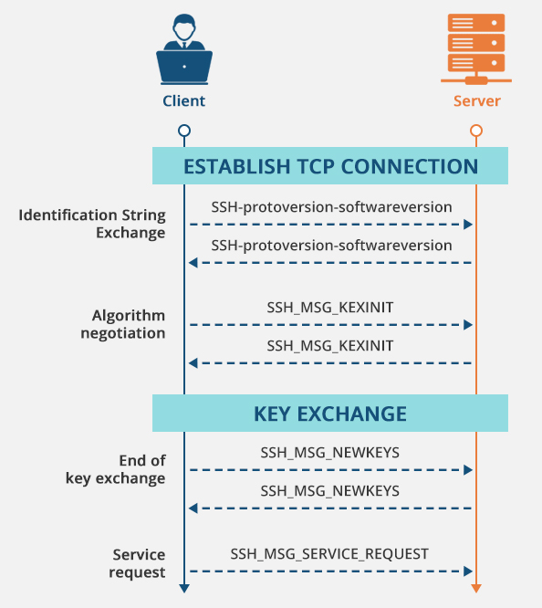
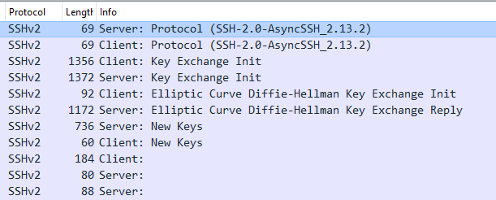
The SSH Hanshake
SSH comunication consists of two parts:
Unencrypted handshake and secure channel.

Slide 4
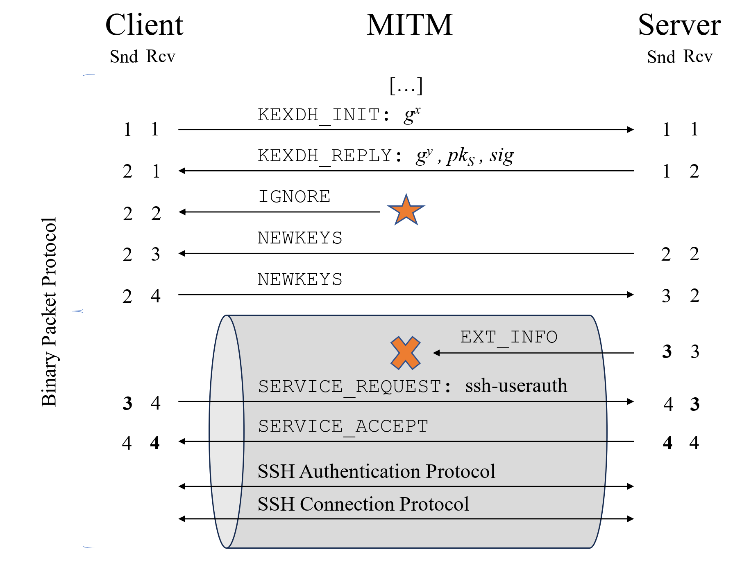
Prefix Truncation
Example
Problem: SSH doesn’t varify all the messages in the Handshake and doesn’t reset sequence numbers.
Impact: you can delete an arbitrary number of messages from the beggining of the secure channel.

Slide 5
Practical use: Rogue Session
Combined with a flaw in the implementation of Asyncssh that allows you to send Authentication Requests during the handshake opens the door to a rogue session attack.
Impact: The attacker has complete control of what the users sees, and can read all conmunication.

Slide 6
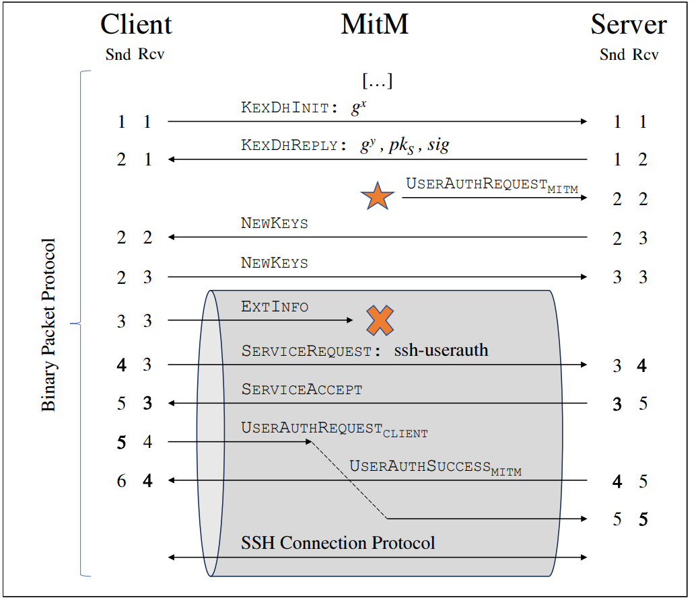
Demo time!
Ilustration:

Slide 7
Affects and Mitigation
While the problem needs addresing, the attack requires an active MITM attacker, and thus not of high priority.
Solving the problem involves one of the following:
Sign all the messages in the handshake
Reset sequence numbers at the beggining of the secure channel

Slide 8
Conclusion
We showed how SSH has an inherit flaw in the way it signs messages in the handshake.
We showed how this can be used to initiate a rogue session.
We explained how it can be fixed and how the implementors of Asyncssh chose to do it.

Slide 9
Any Questions?

Slide 10
Thank you! git: https://github.com/Ykoler/Network-Pentools/tree/main/SSH-Rogue-Session Based on: ”Terrapin Attack: Breaking SSH Channel Integrity By Sequence Number Manipulation” by Fabian Bäumer, Marcus Brinkmann, Jörg Schwenk.

